Slide 1
Coursera Capstone Project Applied Data Science By : Satyajeet Dhawale
satyajit.dhawale@gmail.com
https://github.com/d-satyajit

Slide 2
Introduction
Nagpur is central India biggest city and has the number of interesting places within the boundaries of the city.
There are many places, restaurant and malls in Nagpur, where many people visits on daily basis. Also, due to new style of food delivery many people here have opened several home based small food restaurants and people prefer ordering from them.
Hence to succeed with retail there has to better way of selecting a nearby restaurant and provide a fast accessible experience.

Slide 3
Business Problem
Now and then everyone wants to eat from outside and also people go for business lunch/dinner or required food for partying at home.
The main idea is to find the ideal nearby, optimal and most density restaurant for the customer base in city.

Slide 4
Data Collection
All the major locations in Nagpur city were taken from the Wikipedia page (https://en.wikipedia.org/wiki/List_of_localities_in_Nagpur) and scraped using BeautifulSoup library in Python.
To get the latitude and longitude of each location I have used Geocoder library in python and stored in csv file for each location.
The venue data is then found via the FourSquare API by passing coordinates of each location. And all the venue data is captured in another new DataFrame.

Slide 5
Methodology
Precision of the Geocoder library in Python : It was noted that for some location the Geocoder library was giving the incorrect coordinates. And hence few of the locations has to be checked manually and changes because they were having same name as other locations in India. Also, some names were incorrectly mention in the Wikipedia that also needs to be corrected.
Folium : Folium is used to display the location points on the virtual map and for the cluster visualization.

Slide 6
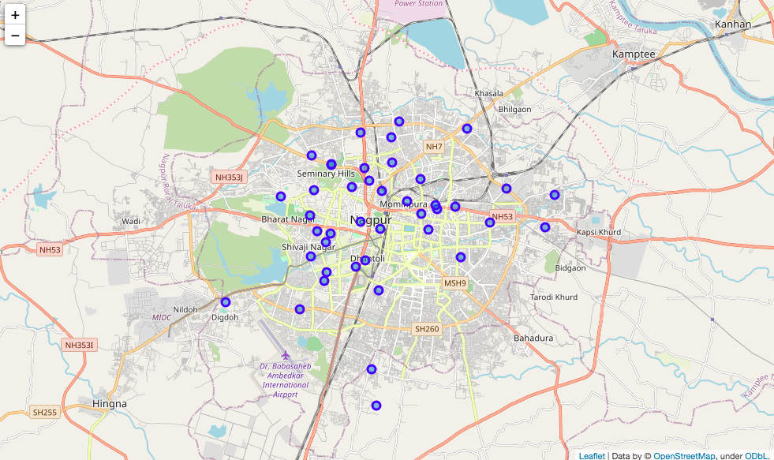
Methodology
Figure : Neighborhood's of Nagpur.

Slide 7
Methodology
One hot encoding : One hot encoding is a process by which categorical variables are converted into a form that could be provided to ML algorithms to do a better job in prediction. For the K-means Clustering Algorithm, all unique items under Venue Category are one-hot encoded.
Top 10 most common venues : Due to high variety in the venues, only the top 10 common venues are selected and a new Data Frame is made, which is used to train the K-means Clustering Algorithm.

Slide 8
Methodology
Optimal number of clusters: Silhouette Score is a measure of how similar an object is to its own cluster (cohesion) compared to other clusters (separation). The silhouette ranges from -1 to +1, where a high value indicates that the object is well matched to its own cluster and poorly matched to neighboring clusters. Based on the Silhouette Score of various clusters below 20, the optimal cluster size is determined.
K-means clustering: The venue data is then trained using K-means Clustering Algorithm to get the desired clusters to base the analysis on. K-means was chosen as the variables (Venue Categories) are huge, and in such situations K-means will be computationally faster than other clustering algorithms.

Slide 9
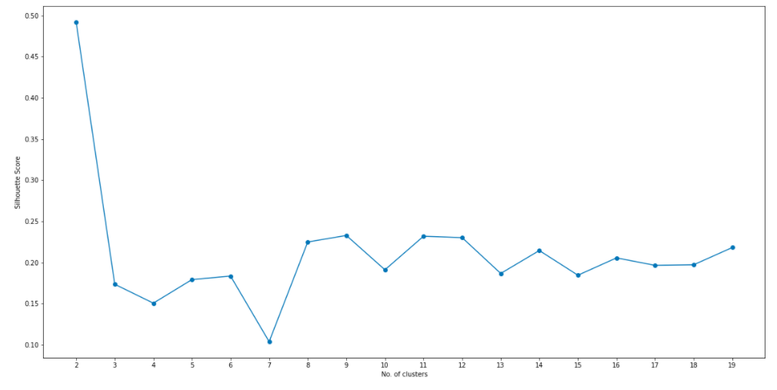
Methodology
Figure : Silhouette score vs Number of clusters.

Slide 10
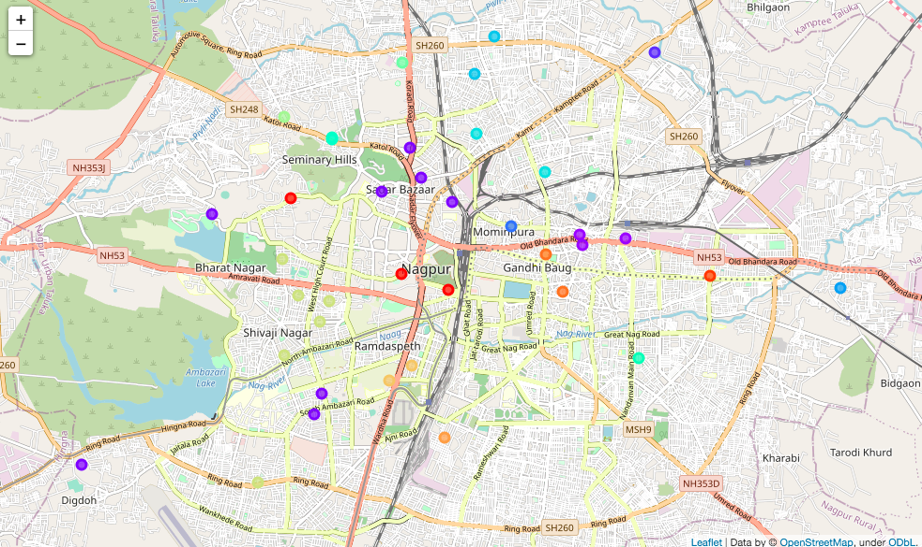
Results
The neighborhoods are divided into ‘n’ clusters where ‘n’ is the number of clusters found using the optimal approach.
The clustered neighborhoods are visualized using different colors so as to make them distinguishable.
Figure : Clustered Neighborhoods of Nagpur.

Slide 11
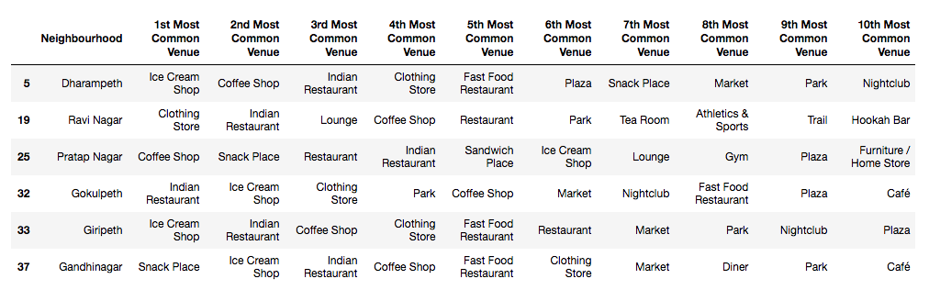
Results
The six places i.e. Dharampeth, Ravi Nagar, Pratap Nagar, Gokulpeth, Giripeth and Gandhinagar area fall in very dense areas of Nagpur and are mostly surrounded with restaurants, ice cream shops, clothing stores, coffee and snacks places.

Slide 12
Discussion
After analysing the various clusters produced by the Machine learning algorithm, cluster no.14, is a prime fit to that shows six different locations having different food corners that includes restaurants, ice cream shops, clothing stores, coffee and snacks places.
These areas fall in very dense areas of Nagpur and are mostly surrounded with people, hence it is obvious that most of the people will go here only. But there is a lot of scope for food business owners to open their food corners in areas other than these six areas.

Slide 13
Conclusion
As the high growing population of the Nagpur City and keeping in mind that India is a country of youngster’s food corners like restaurants, ice cream shops, coffee and snacks places and clothing stores will have high demand.
If the business owners try to focus on the areas where there is a high demand of customers and less food corners their business will definitely will grow. Also, the it will be very beneficial for the people if the food corners will be near to their home.

